Slide 1


SOMERSET PURPOSE
Somerset Academy, Inc. promotes a transformational culture that maximizes student achievement and the development of accountable, global learners in a safe and enriching environment that fosters high-quality education.
S - Set high expectations
O - Objective
M - Meaningful curriculum
E - Effective
R - Resourceful and responsible life long learners
S - Scholars who achieve proficiency and beyond
E - Evaluate continuously and use data to drive curriculum
T - Teachers who are highly qualified

Slide 2
DO NOT. . .
“Hang out” in the stairwells or on the second floor during lunch.
Chew gum. DO NOT BRING GUM!
Go on the basketball court with a skateboard!
Use the elevator without approval from the office.
Leave campus if you are a Middle Schooler, Freshman or Sophomore (Except for DE students)
Allow an underclassmen in your vehicle without prior permission, or you will lose all privileges for the remainder of the school year.
Throw anything off the balcony.
Throw anything from the ground level to the 2nd floor.
Eat or carry food over the basketball court or turf field
Litter or leave garbage around at lunch
Hang out by the wavy wall side or behind the basketball court bleachers
Hang on or grab the basketball nets/rims
Playing “keep away” = a detention
Yoga pants/ leggings/ are not allowed. Not even during dress down days. Dress code violations earn detentions
You are not to go to the Deans’ office during class to argue a detention. You will be turned away.

Slide 3

NO FOOD ON THE COURT

Slide 4
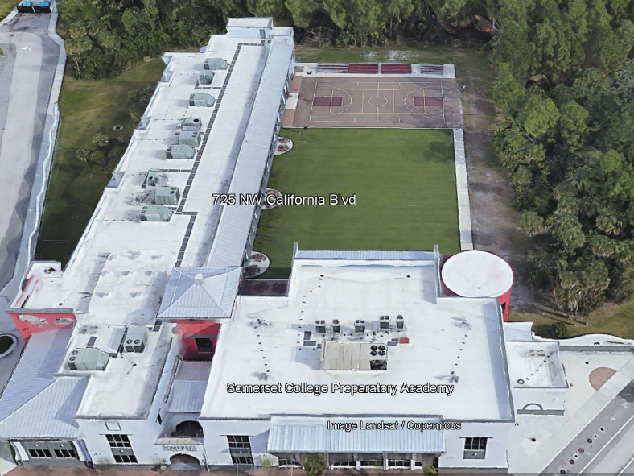

There is NO open food or liquid on the turf!!!
If you are caught, you will be having a meeting with the deans
TURF!

Slide 5
Tutoring Schedule
Mondays – ENGLISH (please see the schedule for which teach is staying for tutoring. The schedule is posted in all English teacher Classrooms)
Tuesdays – Math (ALL Math teachers)
Wednesdays – Social Studies
Thursdays – Science
Fridays – NONE
Need tutoring for electives? See your teacher to schedule.

Slide 6
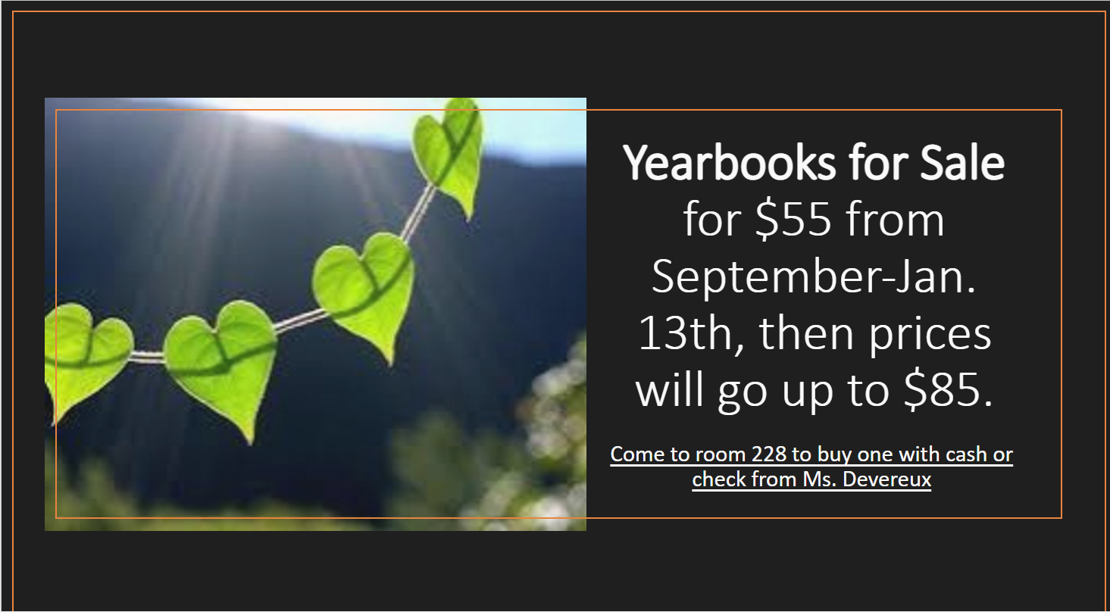

Slide 7

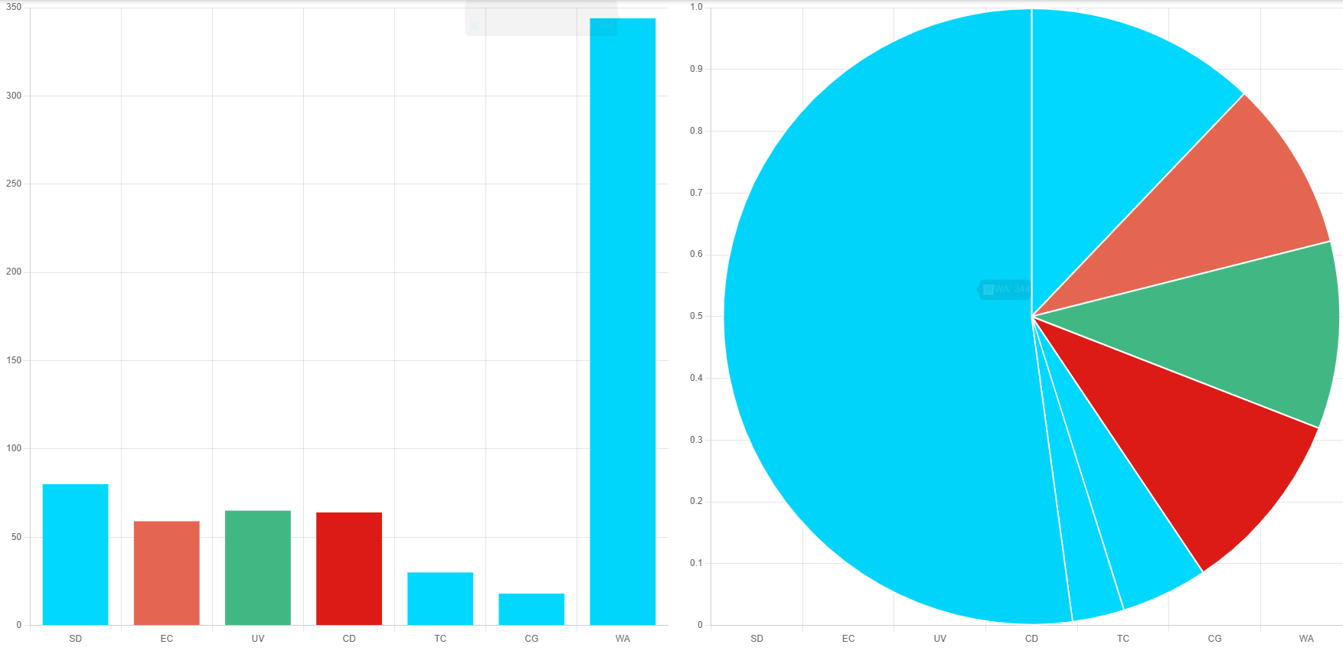
Total of 18 Days of School in February
Warnings
344
Saturday
Detentions
80
Average of 19 Warnings issued
Per day for February
Electronic
Confiscation
59
Warnings 344
Uniform Violation
65
Class Disruption
64
Saturday
Detention
80
Electronic
Confiscation
59
Uniform
Violation
65
Class
Disruption
64
Tardy to
Class
30
Gum
18
Tardy to
Class 30
Chewing
Gum 18

Slide 8
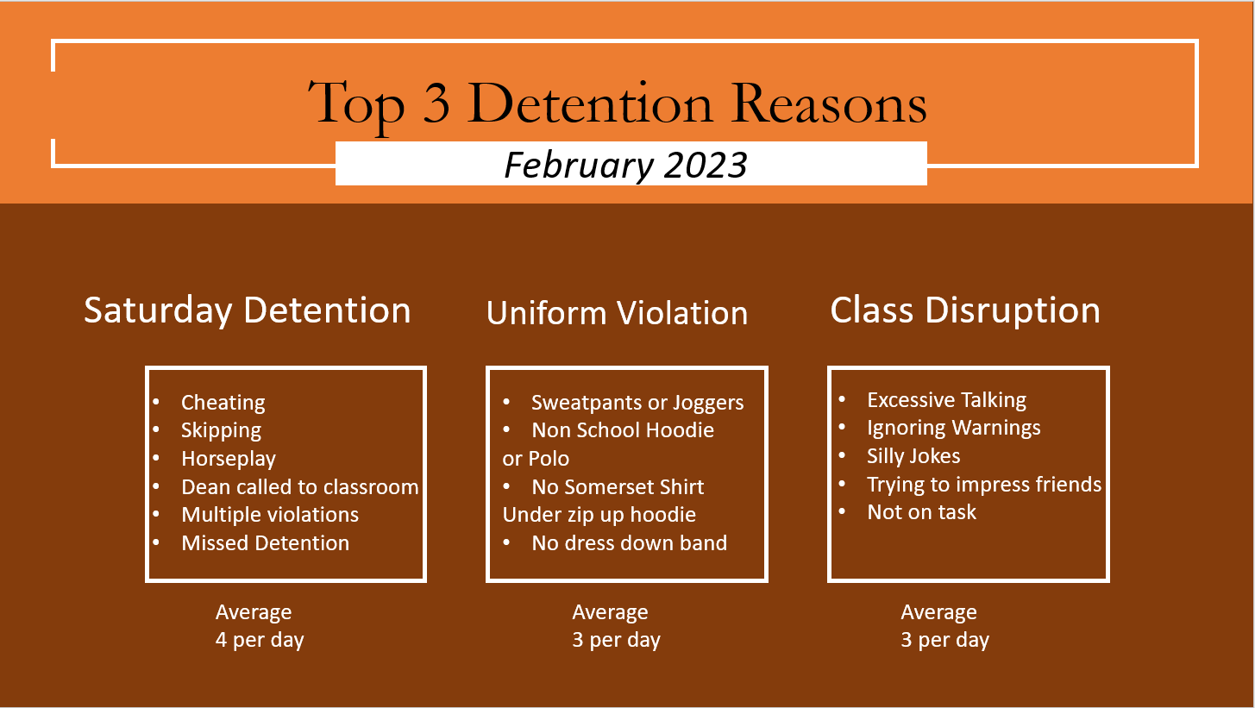

Slide 9


Slide 10


Slide 11
Attention 11th and 12th grade students only
SAT TEST
3/22/23
Testing will begin at 8:15

Slide 12





Attention Students
Do Not Spray any Body Sprays , Perfumes or Cologne's in the Restroom or Locker rooms. Anyone caught will receive a Detention

Slide 13
Dress Code Violations (Do Not Wear)
Non-Somerset Hoodies, Polos or Sweatshirts
Ripped or Frayed Jeans
Sweatpants, Joggers or Pajama Pants
Crocs or Slides

Slide 14
Discipline Matrix (Uniform Violation)
Warning
A warning issued by 1st period teacher or Staff. Email sent home via Concierge.
Tuesday & Thursday inside the cafeteria. Attendance will be taken; 30 minutes to eat lunch and 20 minutes to clean up inside and outside of cafeteria
Monday Detention
Monday Detention afterschool. 3:50pm to 4:50pm
Lunch Detention
Saturday Detention
Referral & Behavior Probation
Saturday Detention
9:30am to 12:30pm
Referral and 9-week behavior probation contract.
1st Offense
2nd Offense
3rd Offense
4th Offense
5th Offense

Slide 15
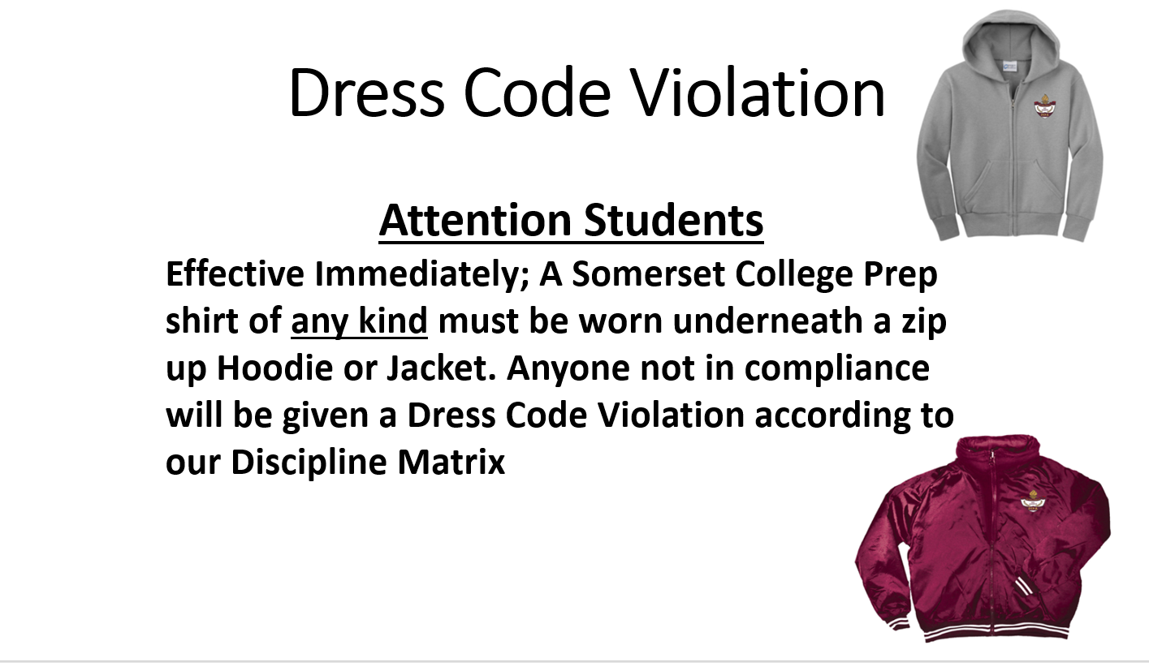

Slide 16

Annual Pop Tab Drive
March 27-March 31 starts SGA's annual pop tab drive!
Bring in all pop tabs to the cafeteria and drop them off in assigned house containers.
This is a House Competition and points will be awarded to the top three Houses.
Points will be determined by weight in lbs.
All pop tabs will be donated to the Ronald Mcdonald House Charites to provide housing and food for families of patients at Children's Hospital.

Slide 17

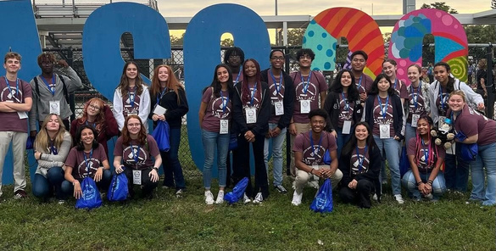





ARE YOU INTERESTED IN JOINING SGA
(STUDENT GOVERNMENT ASSOCIATION)?
LEARN ALL ABOUT SGA AND YOUR FUTURE POSITION!
You MUST attend at least ONE of the following informational meetings in order to join
MEETINGS WILL BE HELD ON:
APRIL 4th, 5th, and 6th, DURING LUNCH IN ROOM 222.

Slide 18
FUTURE POSITIONS INCLUDE THE FOLLOWING:
SENIOR POSITIONS (CLASS OF 2024)
PRESIDENT, VICE PRESIDENT, SECRETARY, TREASURER, AND REPRESENTATIVE
JUNIOR POSITIONS (CLASS OF 2025)
5 REPRESENTATIVES
SOPHOMORE POSITIONS (CLASS OF 2026)
5 REPRESENTATIVES
FRESHMEN POSITIONS (CLASS OF 2027)
5 REPRESENTATIVES
MIDDLE SCHOOL POSITIONS (CLASSES OF 2028 AND 2029)
1 REPRESENTATIVE PER GRADE

Slide 19
FUTURE POSITIONS ALSO INCLUDE THE FOLLOWING:
HOUSE PREFECTS
1 REPRESENTATIVE PER HOUSE
(MUST BE IN HIGH SCHOOL)
SPECIAL POSITIONS
PARLIAMENTARIAN
HISTORIAN
TECHNOLOGY COORDINATOR (NEW!)
GRAPHIC DESIGNER (NEW!)
(MUST BE IN 10, 11, OR 12 GRADE FOR ALL OF THESE)

Slide 20
What is Student Government?
Student Government Association (SGA) is an organization of elected student representatives who act as the official voice of the student body that communicates student concerns and opinions to school administration and staff. They work to enhance the academic, social, and cultural experiences of their fellow students by hosting events such as drives, fundraisers, competitions, and other activities.

Slide 21
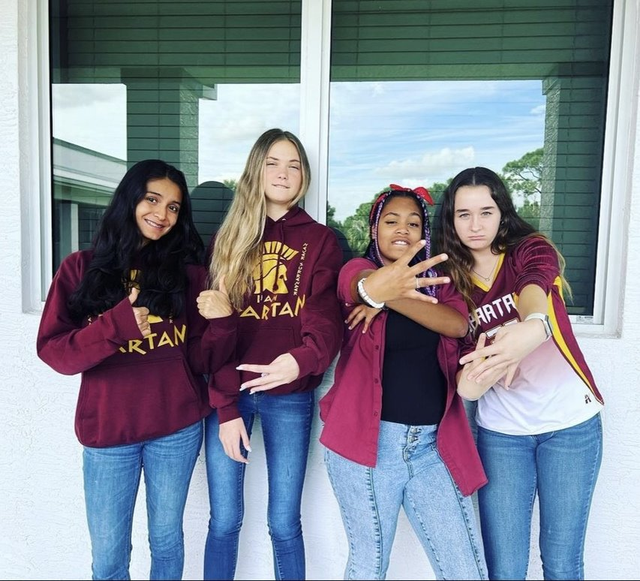
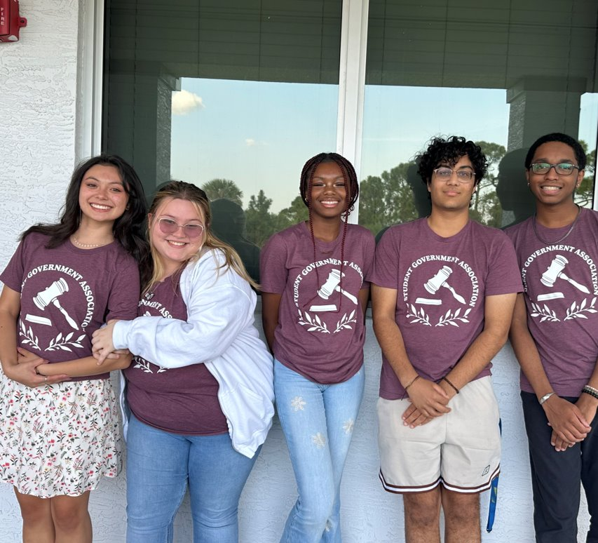
Senior Officers
President Brianna Tucker, Vice President Savannah "Ozzy” Sternberg, Secretary Carlie Abraham, Treasurer Milan Patel, and Senior Representative Dylan Haripersaud
Junior Officers
Katherine Espinoza, Lily Hamel, Kaylani "Kay" Arnold, and Keely Moody.

Slide 22
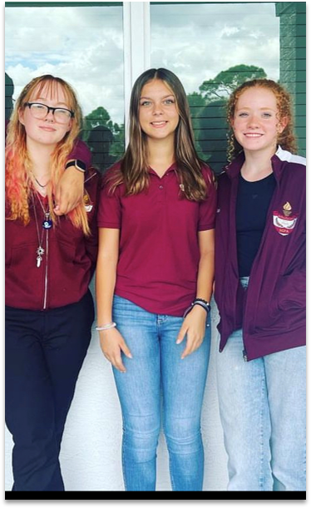
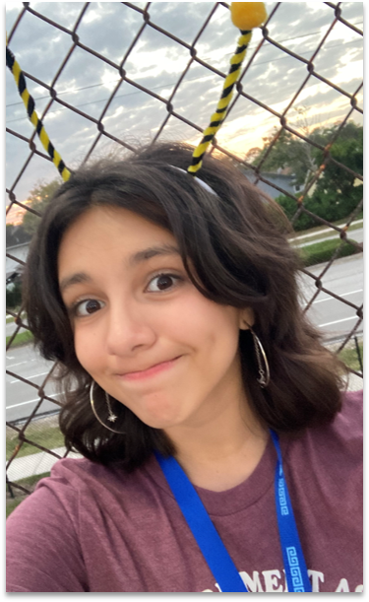
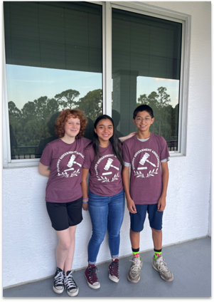
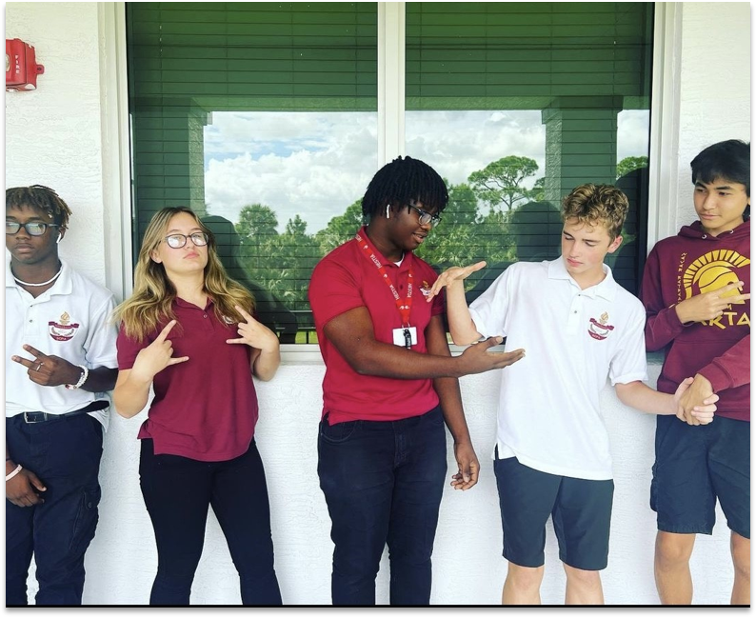
Middle School Representatives
8th Grade - Reagan Kenny
7th Grade - Katherine Campos
6th Grade - Angel Campos
Sophomore Officers
Marcus Jackson, Mackenzie Wilkins, Richardson Barthelemy, Davis Rule, and Kenji Rodriguez.
Freshmen Officers
Emily Wittry, Kendall Coberly, Tori Huckstep, and Victoria Zaravelis

Slide 23
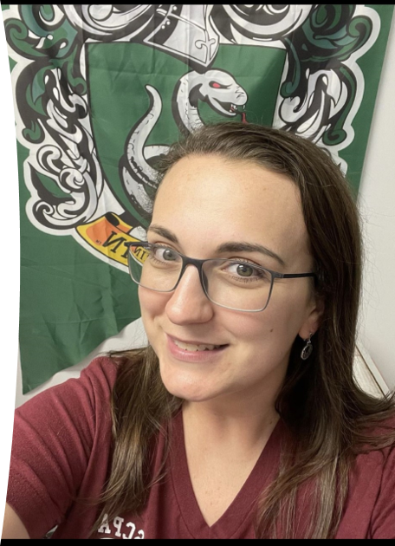
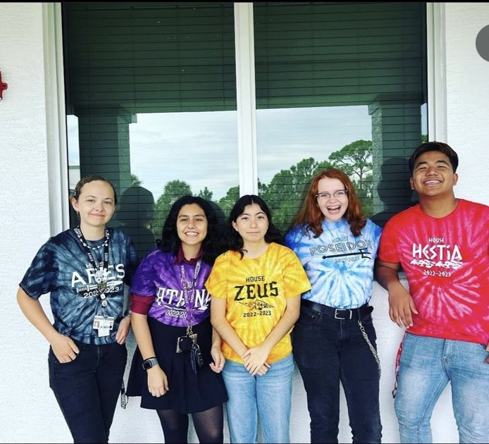
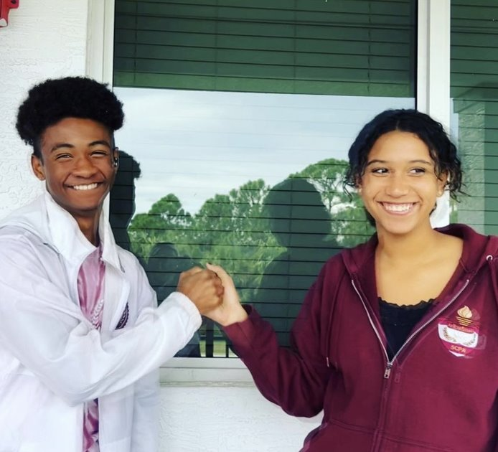
Special Positions
Parliamentarian: Aidan Lawrence and Historian: Estrella "Stella" Romero
House Representatives
Ares - Madison Shore
Athena - Alexa Saenz
Zeus - Vivan Solis
Poseidon - Alexandria Akelaitis
Hestia - Nang Mung
Sponsor
Mrs. Butler has been the sponsor of SGA for 6 years. If you have any questions pertaining to SGA or its events, you can find her in Room 222 or email her at butler.ashley@somersetcollegeprep.org. ​

Slide 24
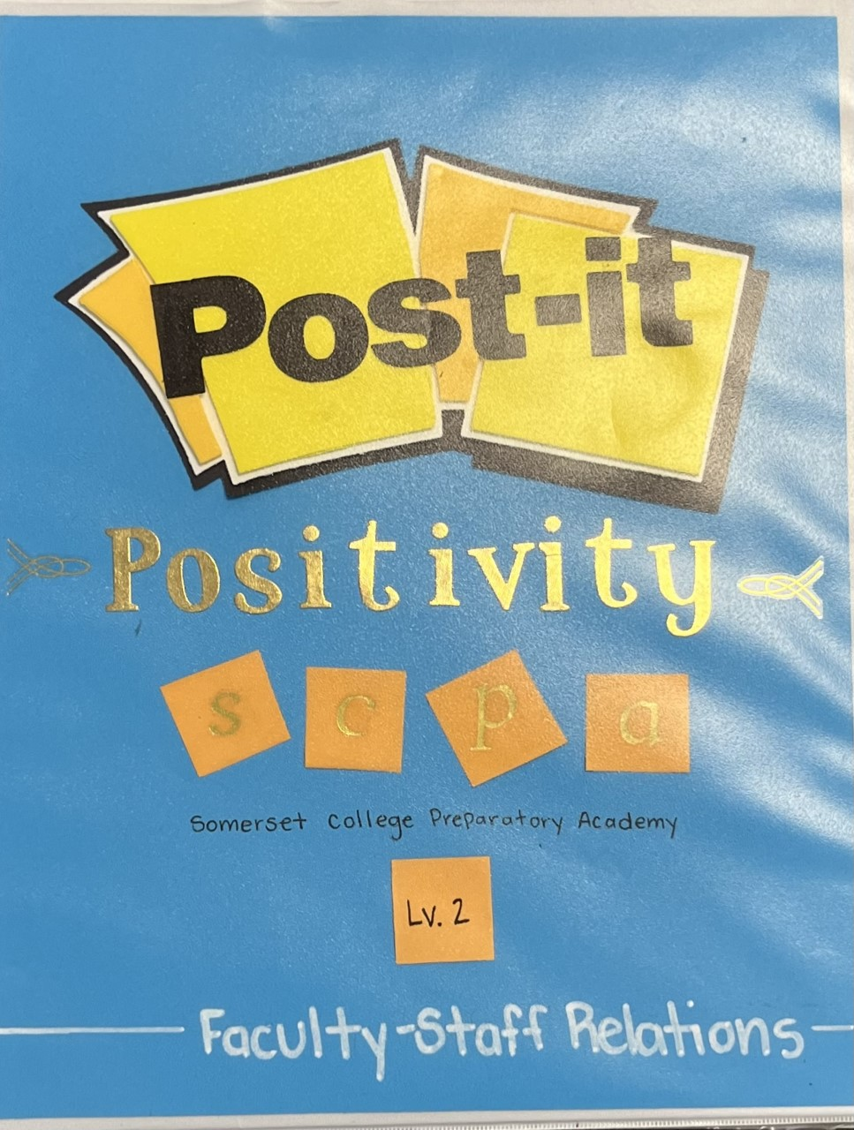
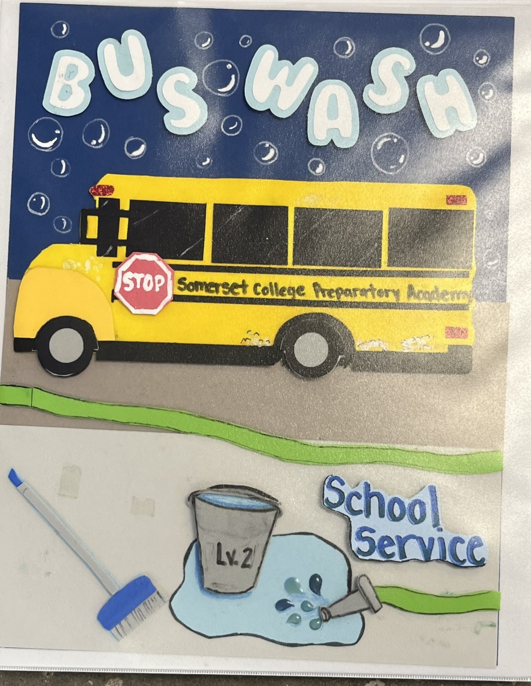


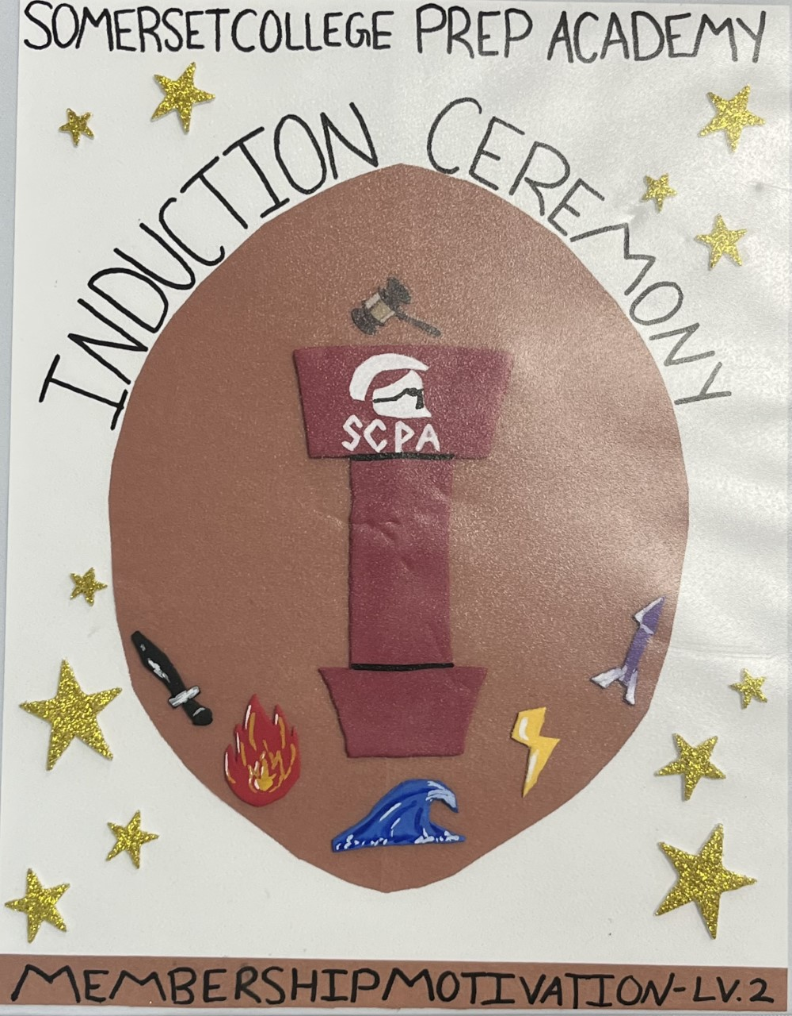
Committees
School Service
Work to help around the school
Plan events such as: Bus Wash, Suggestion Forms, Sponsor Seniors for Senior Fees; Donate to Other School Clubs (Ice Pops to D&D, FBA donations, etc.)
Faculty and Staff
Connect students and staff on campus
Maintain bonds between the students and staff
Plan events such as Teacher Appreciation Week, Tueste Coffee Bar, Post-It Positivity
School Spirit
Increase school pride amongst students and staff
Plan events such as: Theme Nights, House Games, House Merchandise, Spartans Rocks, Field Day, Homecoming, Spirit Week, Winter Wear Dress Down, etc.
Membership Motivation
Maintain positive bonds between members of the organization
Create a welcoming body that encourages student to run for representative positions
Plan events such as: Games at SGA meetings, Induction Ceremony
Community Service
Partners with local organizations to service those in need
Plan events such as: Breast Cancer Walk, Pop Tab Drive

Slide 25



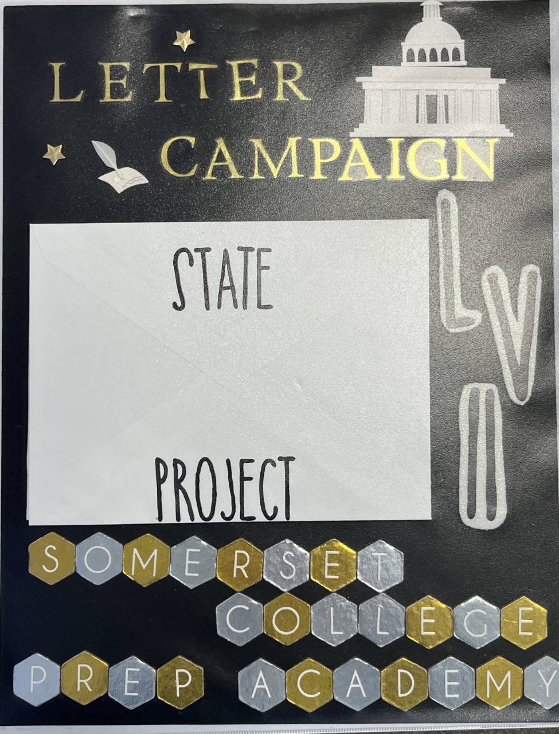

Committees
Fundraising
Manage funds of the SGA account to fund school events and charitable donations
Plan events such as: selling Crumbl and Urban Air Spirit Night
Citizenship Development
Encourages involvement in local government
Plan events such as: SGA elections, SCPA Take PSL
Health and Safety
Provide information and equipment for students and staff to maintain a healthy and safe lifestyle
Plan events such as: Blood Drives, Feminine Product Drive
Environmental Concerns
Address issues and topics that affect the environment in our school and community
Plan events such as: Guest Speakers, Promise Garden (event happening at Bethany)
State Project
Focuses on the Florida Association of Student Council President’s topic of interest (changes year by year)
Plan events such as: Letter Campaign regarding Homelessness Awareness

Slide 26

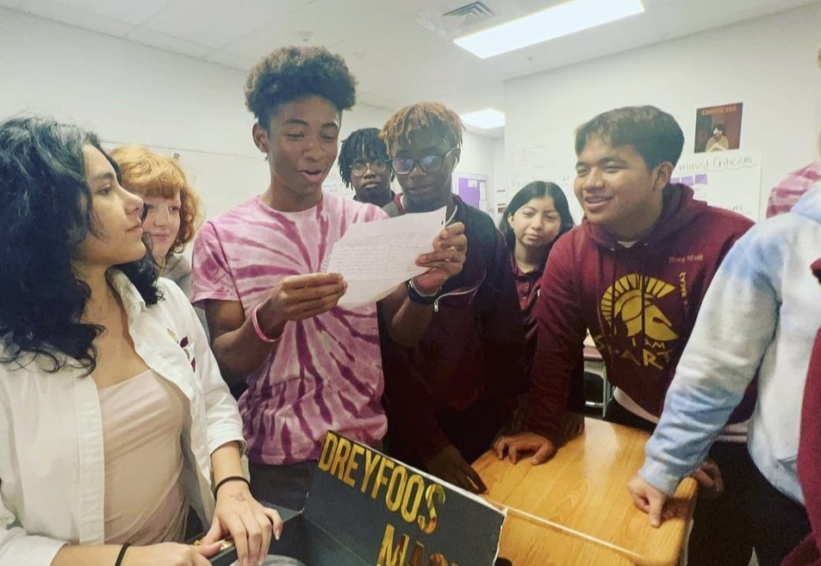
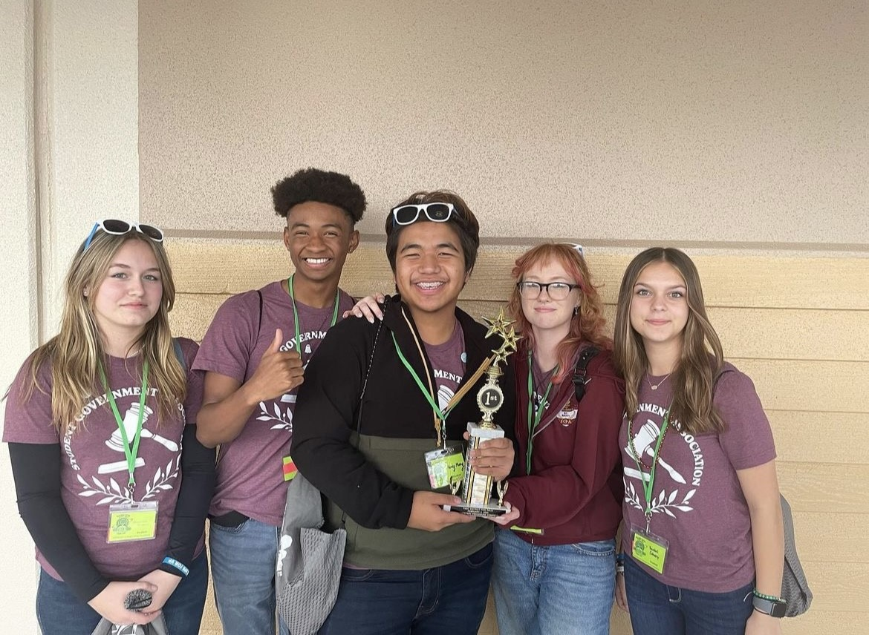
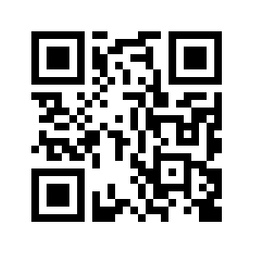
Special Committees
Surprise Box
Pen Pals with a school a part of the FASC community
Conducts meetings according to the Robert’s Rules of Orders and Compete at District and State competitions
Parliamentary Procedures Team
(pictured in the top photo)
(pictured in the bottom photo)
Talent show
Plans the yearly SGA sponsored Talent Show
QR code links to the technology project for this year.
Technology Project
The Years of Somerset Montage Video

Slide 27
What Can SGA Not Do?
What Events Does SGA Host?
Change the cafeteria food
Change dress-code rules
Create new clubs or classes
Build new facilities (such as a library)
Change school/classroom rules
Fire teachers
Create athletic programs or sports
Events run by other clubs (ex. NHS, FFEA, Senior Committee, Prom Committee, Science Olympiad, etc. )
Give access to the roof top pool
PROM
Lock Ins
Blood drives
Homecoming
House Games/Competitions (not Pop-Up House Games)
Fundraisers (such as Dine to Donate [various locations] and Urban Air Spirit Night)
Color specific dress downs/Spirit Week
Teacher Appreciation Week
Talent Show
Field Day
Pop Tab Drive
Senior Handprint Wall
In the past, SGA has hosted:
Valentines Grams
Prom (2021)
Canned Food Drive
Hygiene Product Drive
Glow in the Dark Middle School Dance (2020)

Slide 28

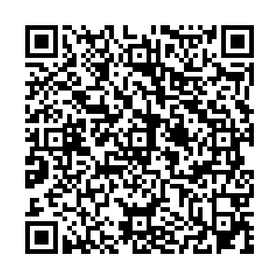
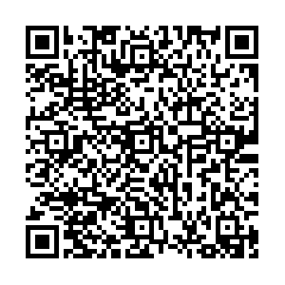



Suggestions
General Suggestion Box
House Suggestion Box
With the QR codes you can give SGA suggestions as to what events and projects that you would like us to organize or host. All suggestions should be appropriate and reasonable.

Slide 29


Slide 30


Slide 31


Slide 32


Slide 33
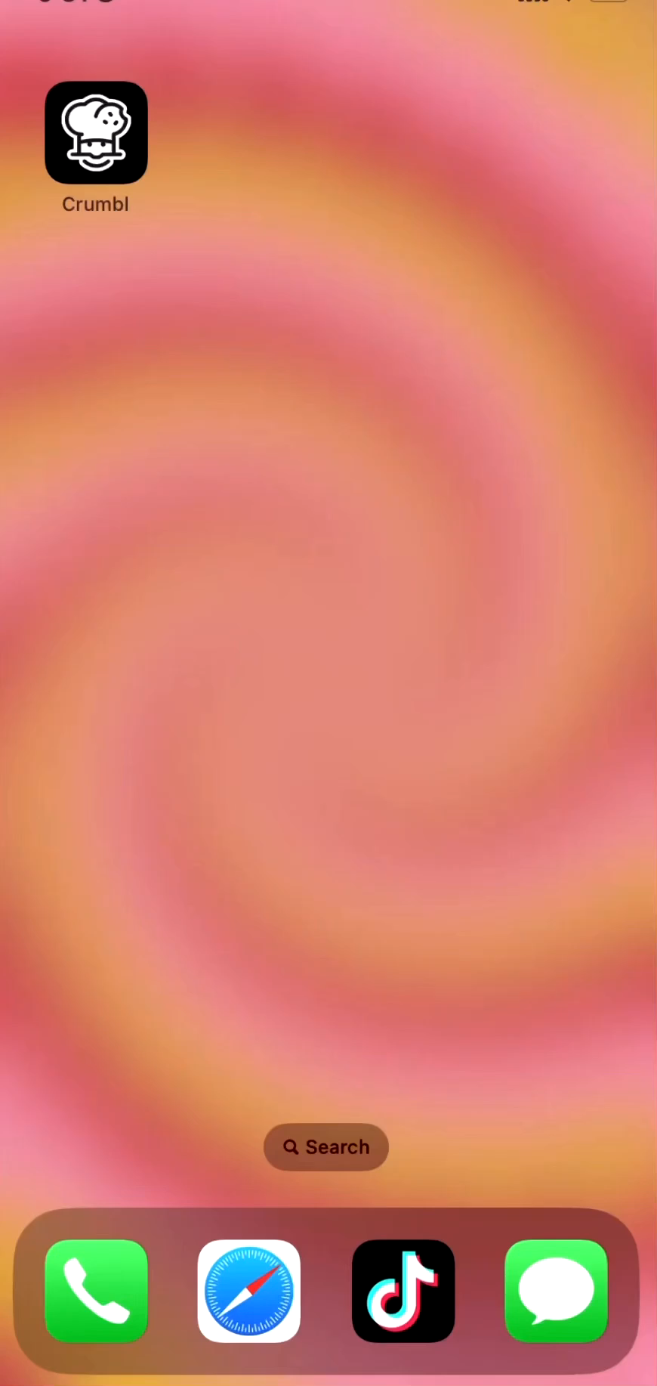
Order your Crumbl
cookies via the app on THURSDAYS only
by following the video directions.
You CANNOT order any other day. Or the order will not be delivered.
DO NOT order the
ice cream.
Message SGA on insta a pic of you with your Crumbl box for a chance to be featured on our page! @scpa.sga

Slide 34


Work for the City of Port St. Lucie!

Slide 35
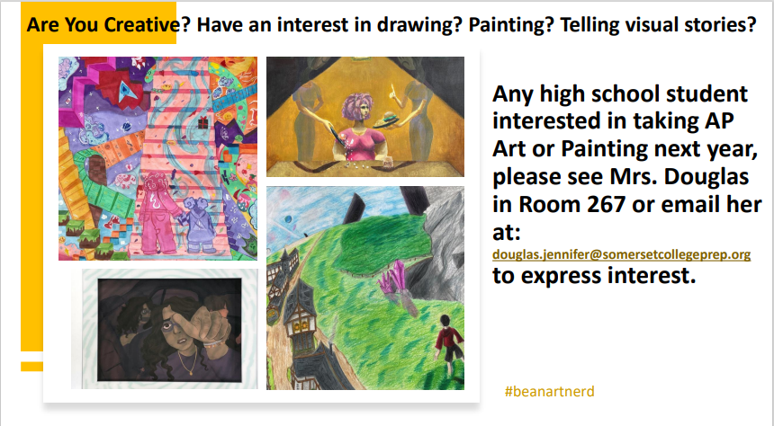

Slide 36

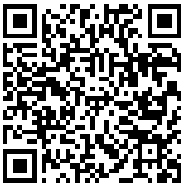
This year's Student Podcast Challenge will open for entries on Jan. 6, 2023 and close on April 28
https://www.npr.org/2022/12/14/1141665744/student-podcast-challenge-contest-npr-2023

Slide 37




TURF DURING LUNCH
Volleyball
Monday-Friday: NO SPIKING!!!
Basketball
Monday/Wednesday: Middle school only
Tuesday/Thursday: Highschool only
Rotate Fridays

Slide 38
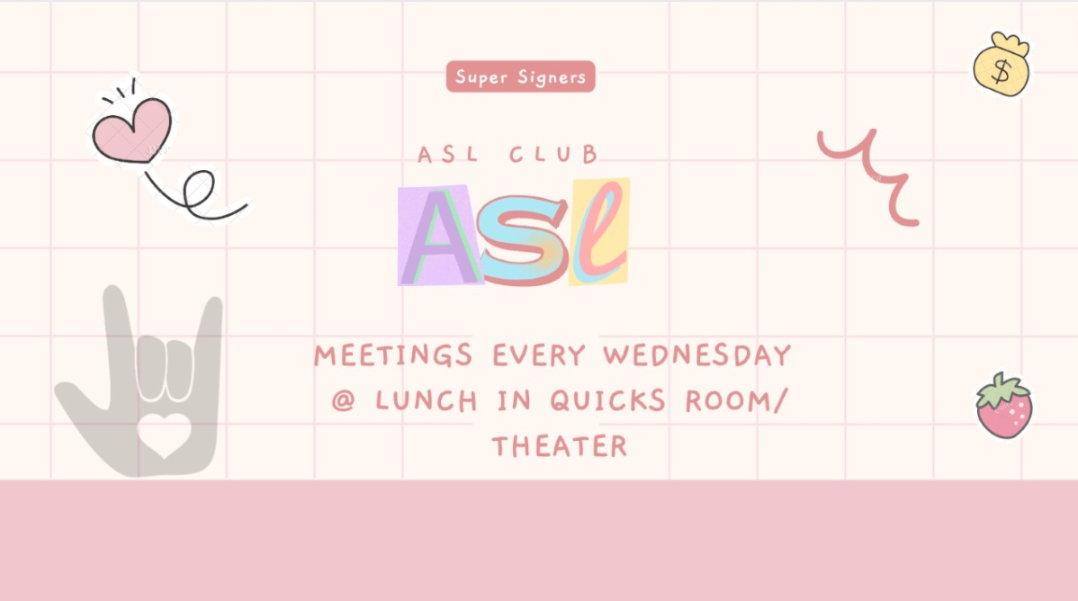

Slide 39
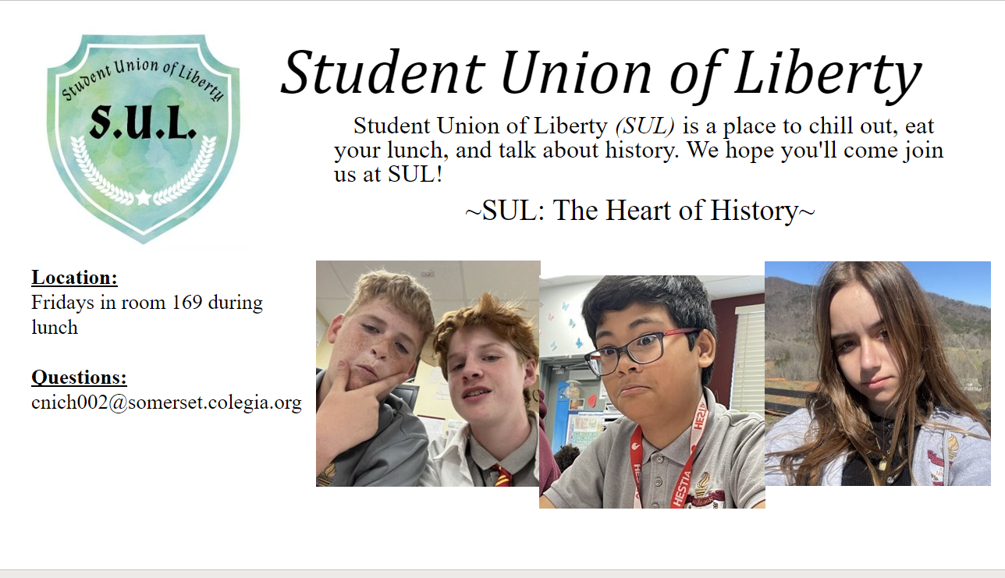
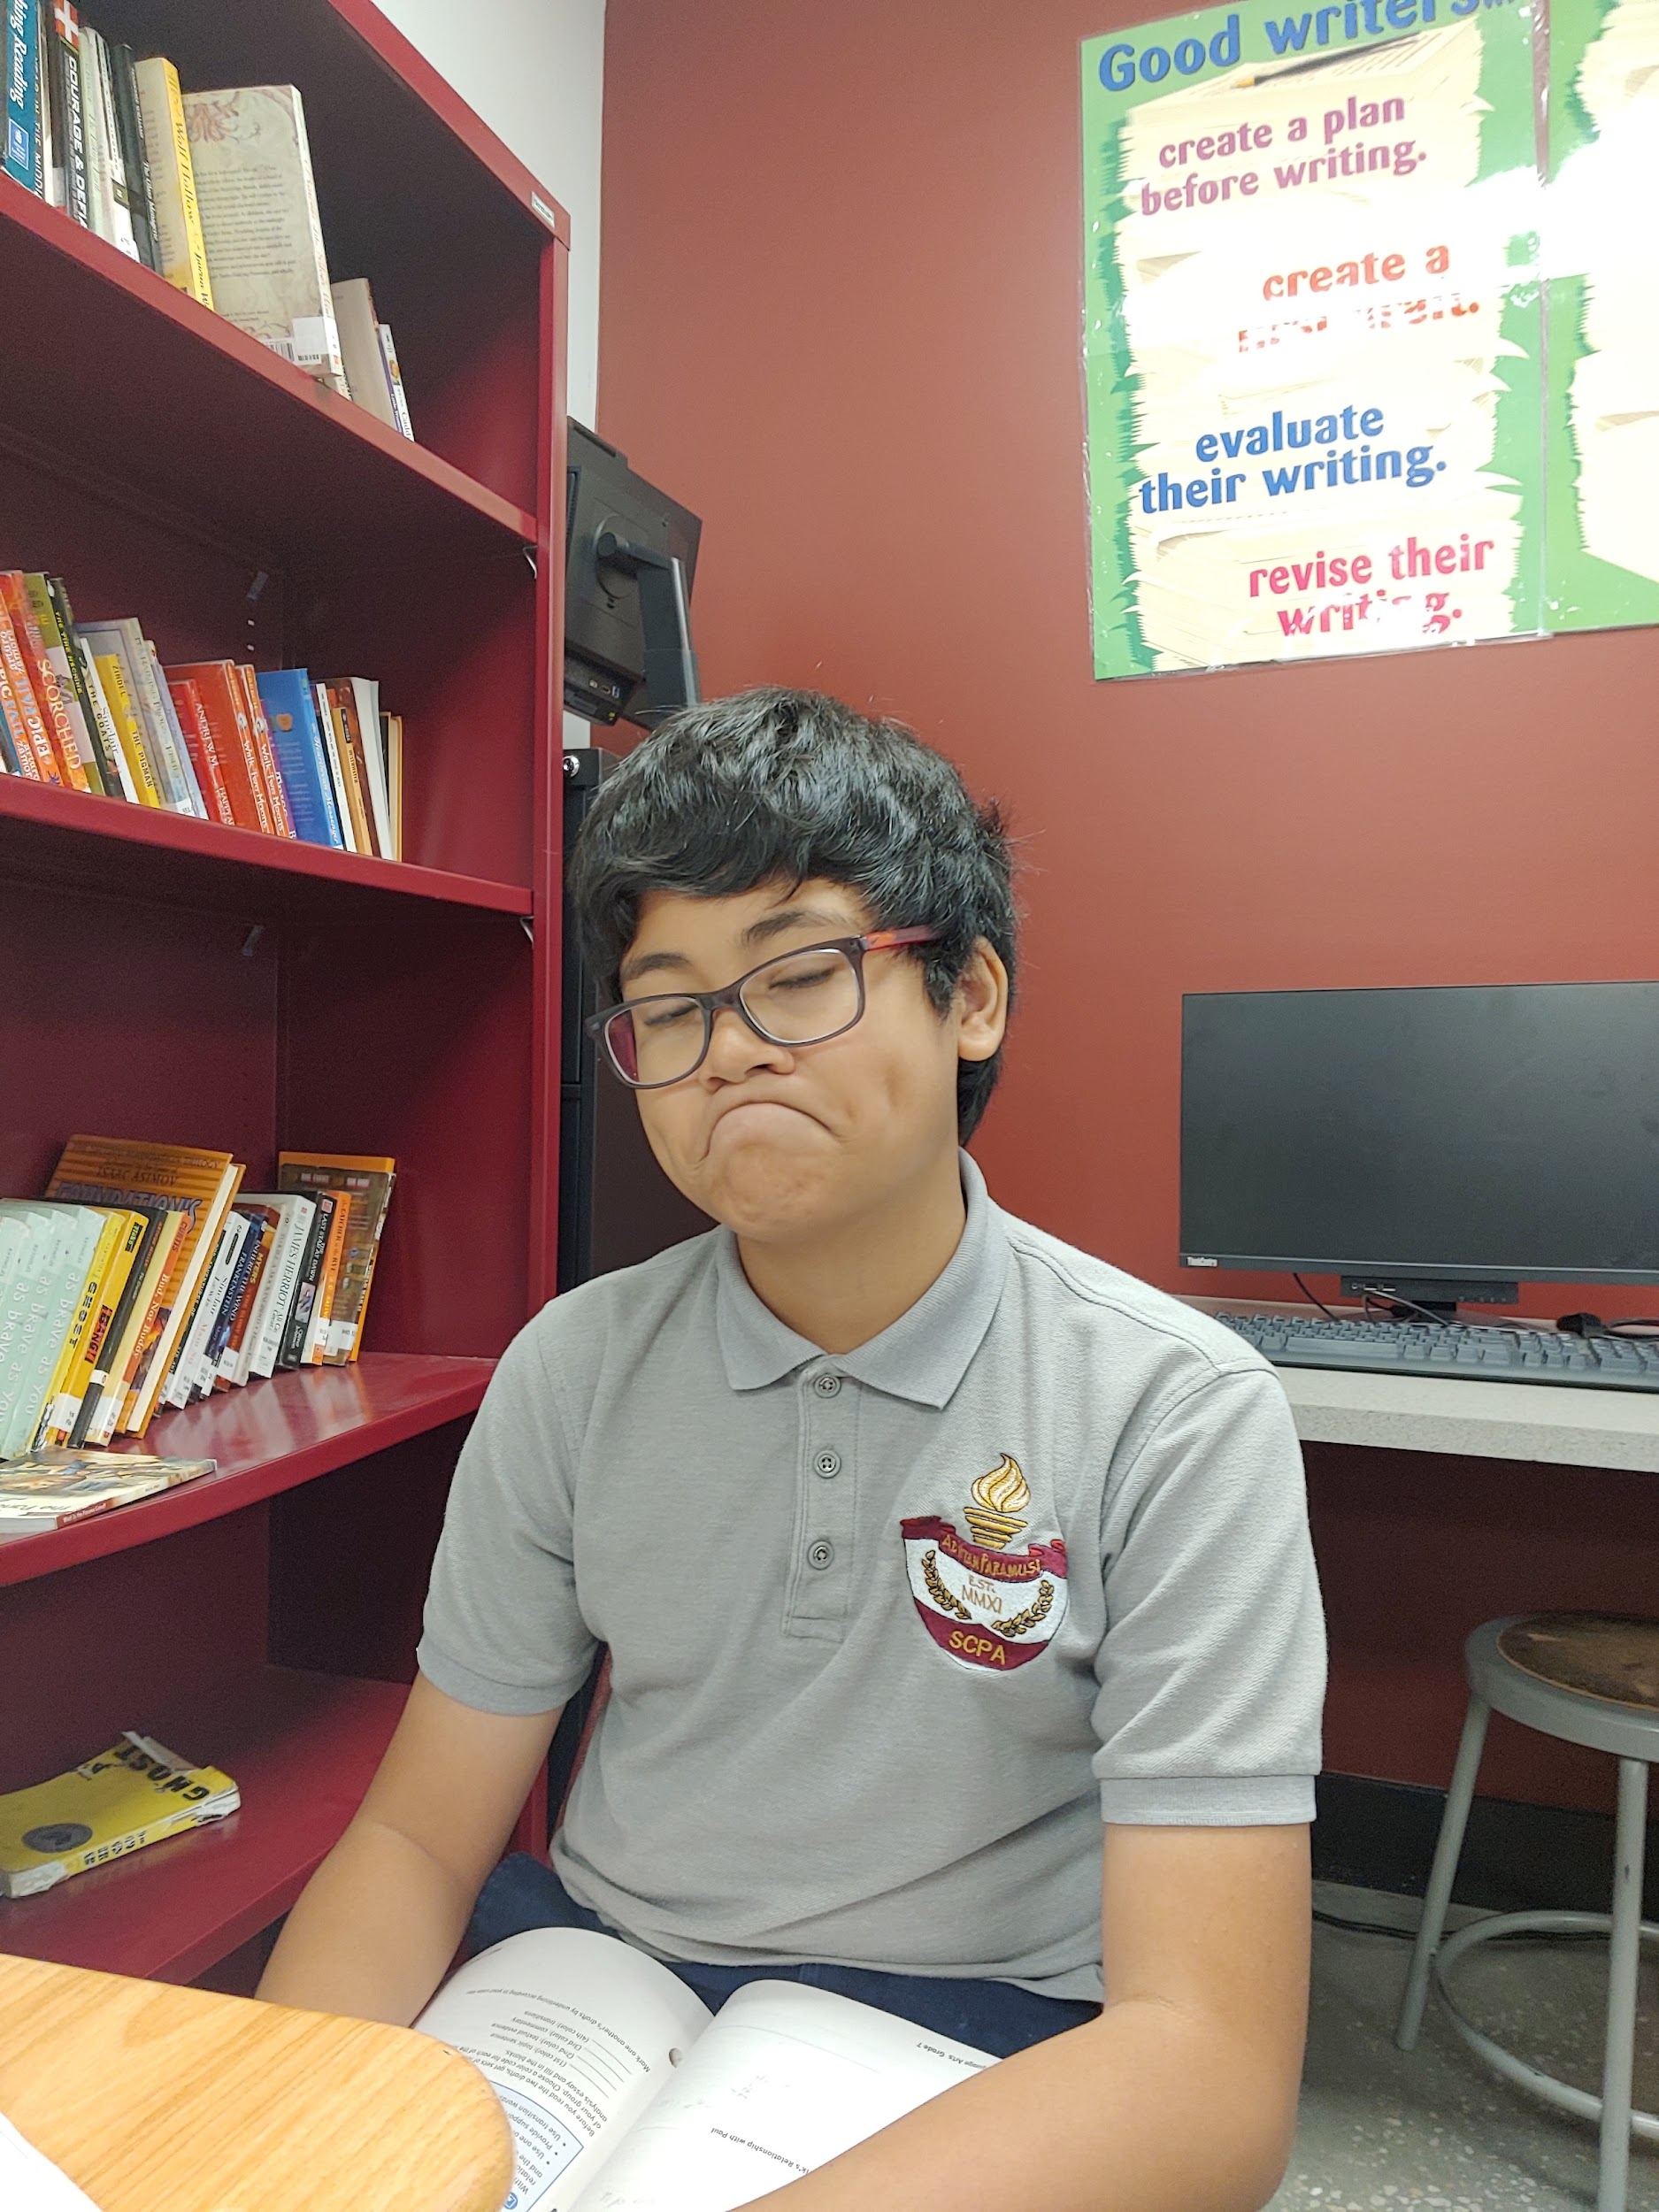
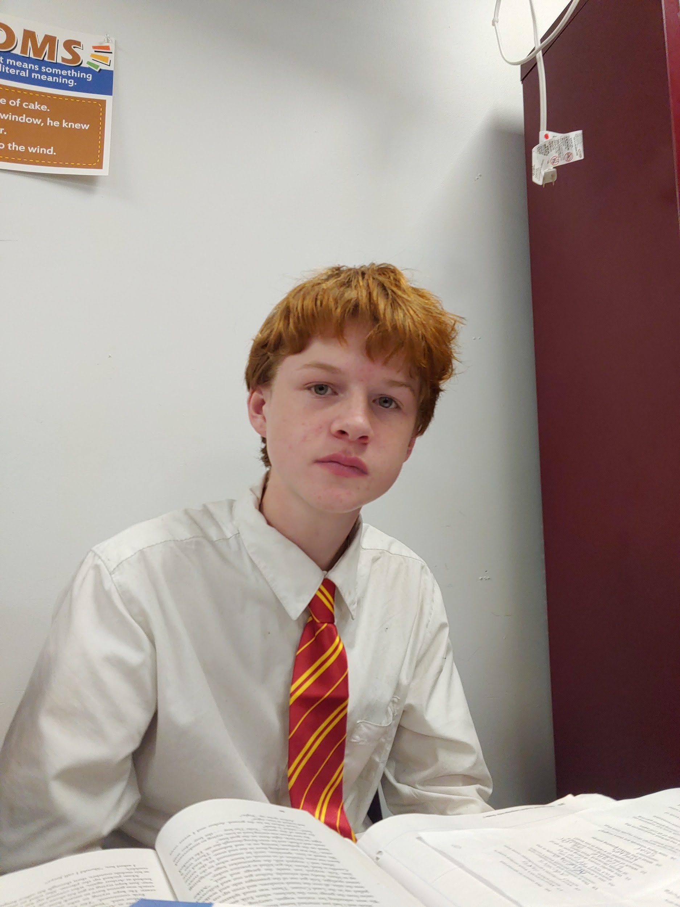
SUL Club
The Heart of History
SUL is a place to be chill, eat your lunch, and learn about history and do history trivia questions.
SUL club will be held in Mr Kyryliw’s class room 169.
If you have any questions email me at:
CNich002@somerset.colegia.org
Starting 3/24/2023 At lunch time

Slide 40
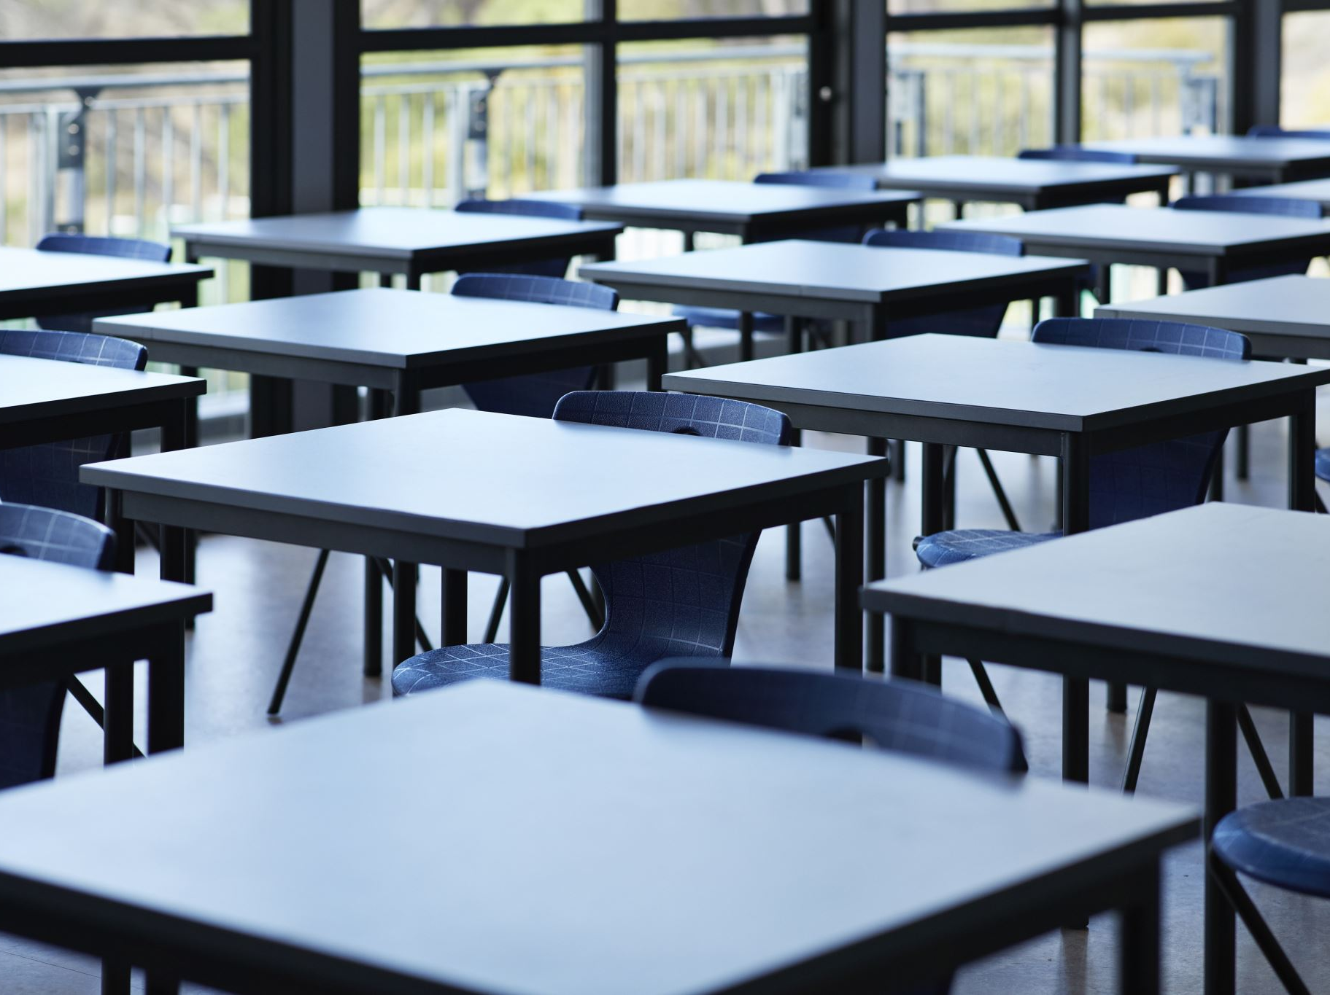
Clubs
Chorus Club for high school on Mondays, after school, in 268
D & D, Mondays, after school, in 175
Mock Trial in 263, on Mondays and Tuesdays during lunch.
Salsa Dancing in 136, on Tuesdays and Thursdays at lunch.
SGA, every other Wednesday, after school, from 3:45-5 in room 222
GSA on Wednesdays in 169 at lunch 11:55am-12:30pm
ASL on Wednesdays in the theater room, at 12pm on lunch.
Chorus Club for middle school on Thursdays, after school, in 268
Chess Club- Thursday at lunch, in 232
Senior Committee Meeting, Thursdays, after school, in 136

Slide 41
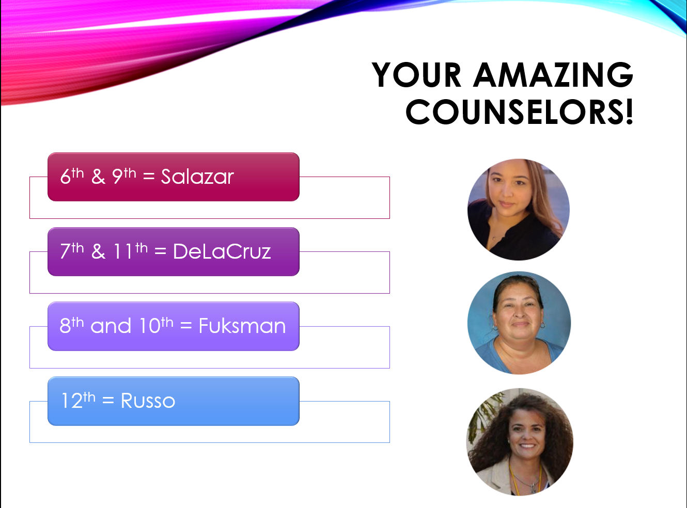
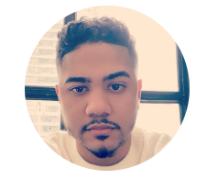

Slide 42





House Reminds
For anyone who needs the house remind this year ☺ This is important for communication with your house head.
  Ares-@houseare
  Athena-@scpaathena
  Hestia- @househes
  Poseidon- @psdnscpa
  Zeus-@housezeus

Slide 43

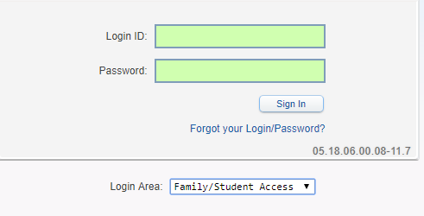
Student Skyward Access
Login ID: (Student 562#)
Password: (8 Digit Birthdate - MMDDYYYY)
Example: 08032005
**You May access Skyward through the school’s website.

